Slide 1


How to be a Gender Trainer
Lucy Ferguson
Follow-up Session
Tuesday 11th March, 2025
Copyright Lucy Ferguson 2025

Slide 2
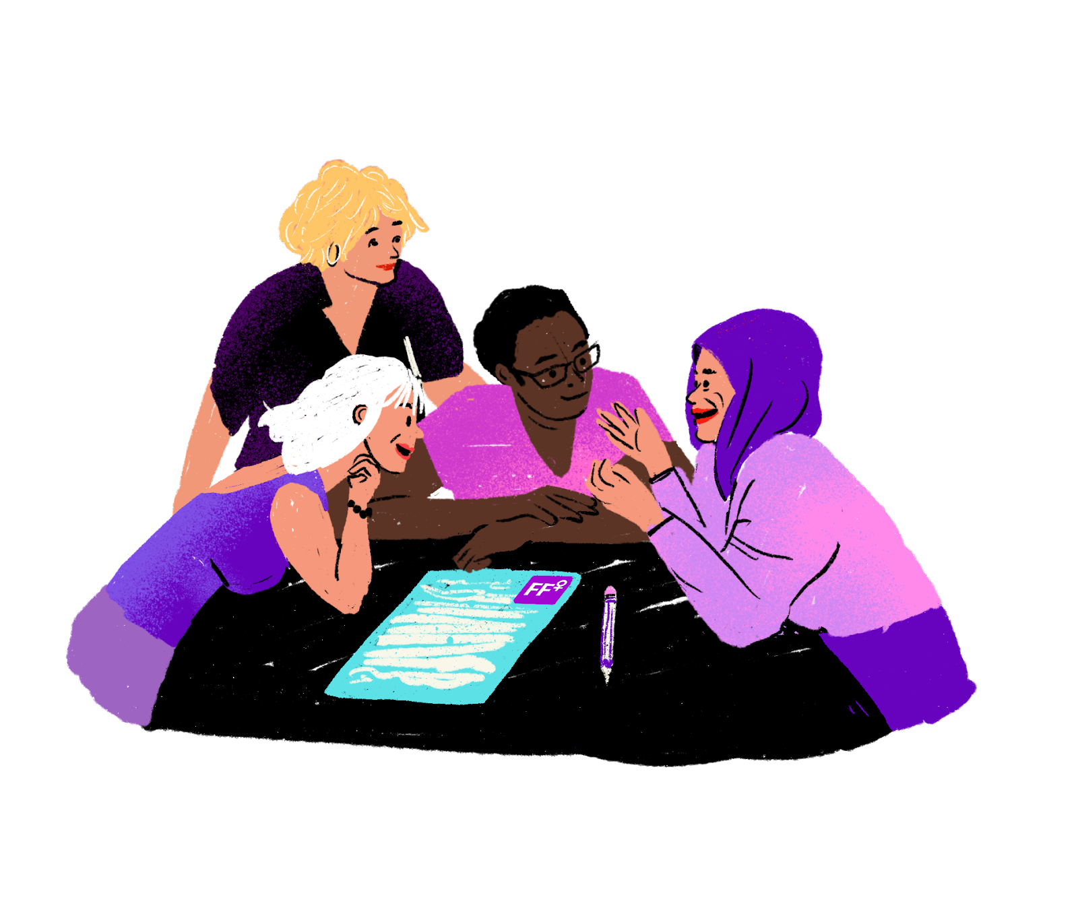
Catching up… (in pairs)

Slide 3

Objectives for today
Identify any successes we have had since the training
Review objectives and support required to reach these
Reflect on remaining challenges we are facing as trainers
Copyright Lucy Ferguson 2025

Slide 4
Sharing successes

Slide 5
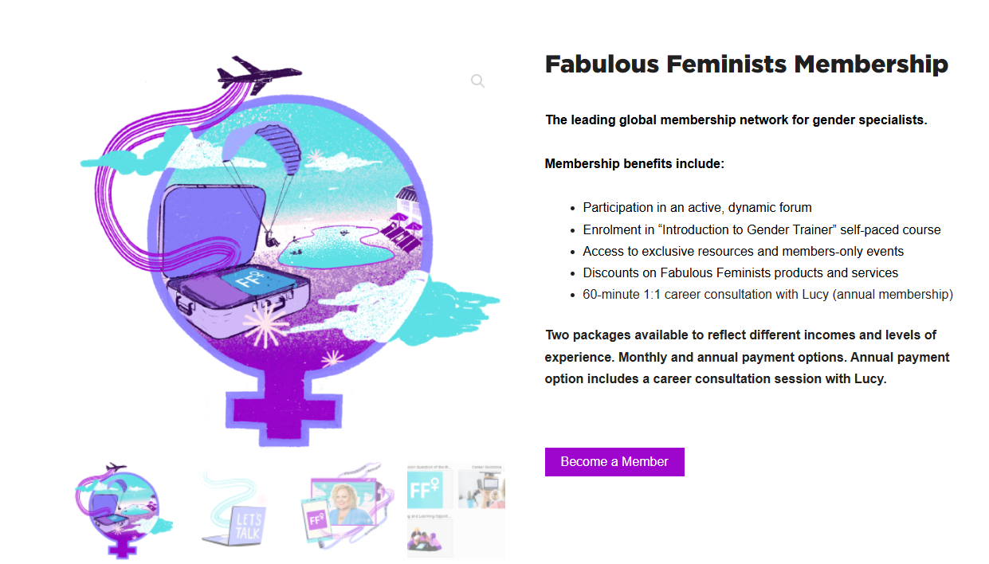
Copyright Lucy Ferguson 2025

Slide 6
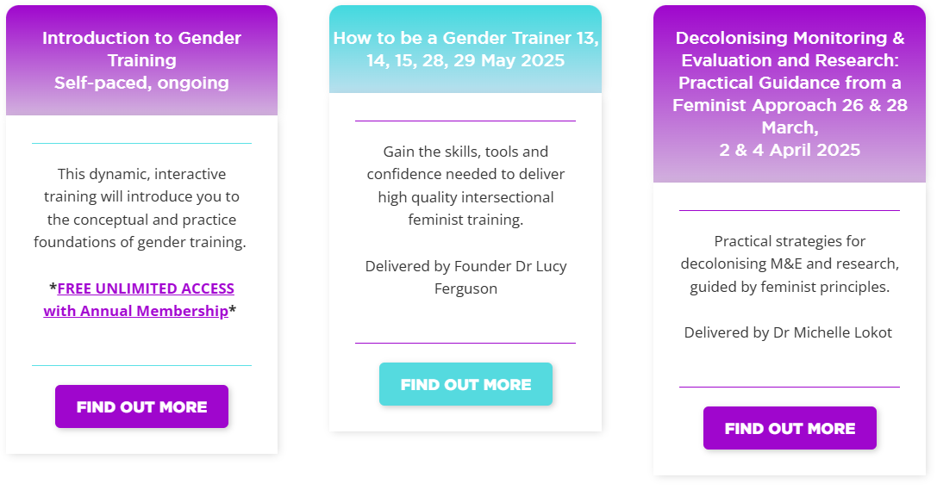
Copyright Lucy Ferguson 2025

Slide 7
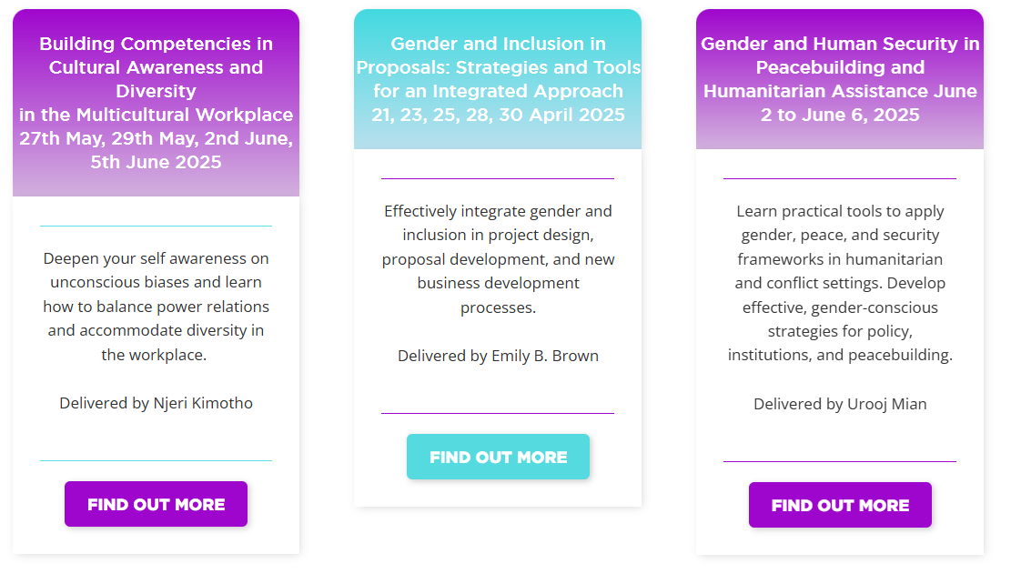
Copyright Lucy Ferguson 2025

Slide 9
Copyright Lucy Ferguson 2025

Slide 10
Gender trainer pathways - review in small groups

Slide 11
Gender trainer pathways
What concrete actions have you taken to achieve your objectives?
Have you been able to access the support and build the skills you need?
To what extent have you met your objectives?
Copyright Lucy Ferguson 2024

Slide 12
Taking action!

Slide 13
Copyright Lucy Ferguson 2024

